Slide 1


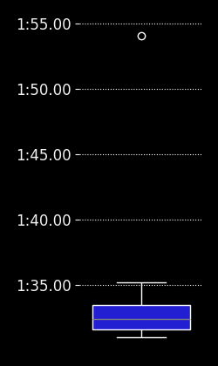
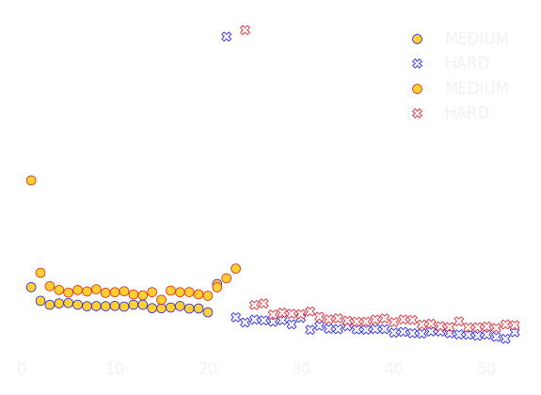
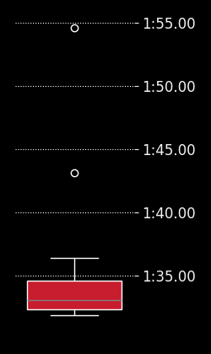
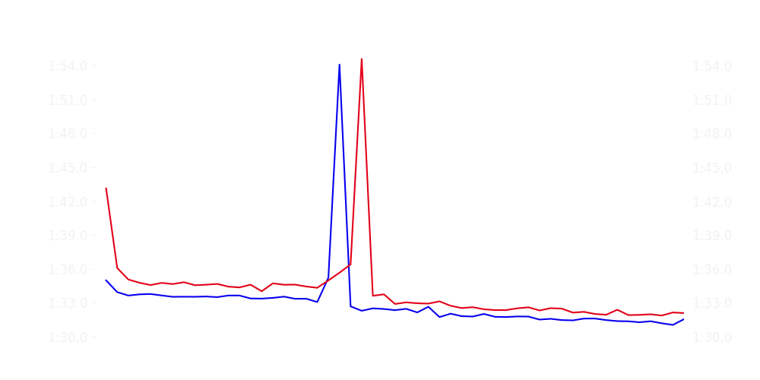
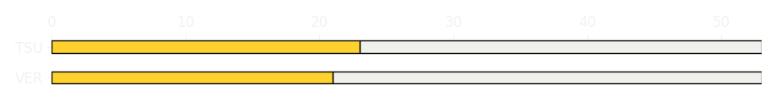
Japanese GP Race
Driver
Race Time
Race Time
Driver
Max Verstappen
1:20:32.258
1:21:22.522
Yuki Tsunoda
Avg Lap Time
1:32.448
IQR
Gap
Gap
IQR
Avg Lap Time
1.925 s
-58.401 s
+58.401 s
2.225 s
1:33.125
Race Comparaison
Race Comparaison
Lap Advantage
51/53
Position
1
Safety Car Lap
0/53
Position
12
Lap Advantage
2/53
Lap Time Per Lap
Lap Time Per Lap
Tyre Strategy
Total Pit Stop Time
00:24.397 s
Pit Stops
1
Pit Stops
1
Total Pit Stop Time
00:24.181 s
Tyre Strategy

Slide 2

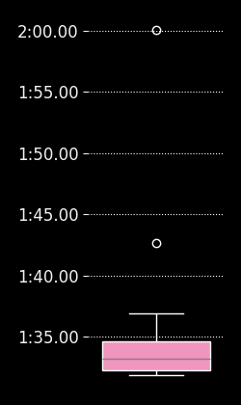
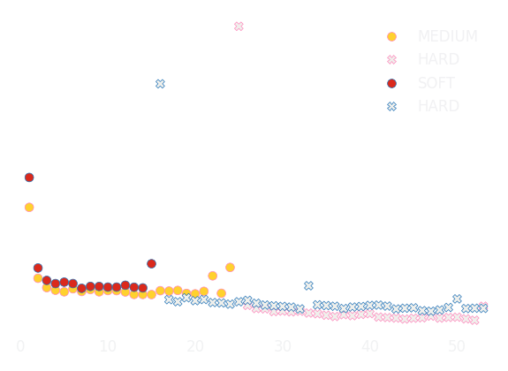
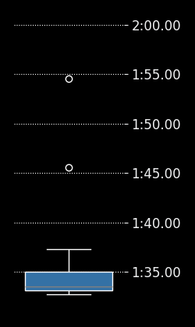
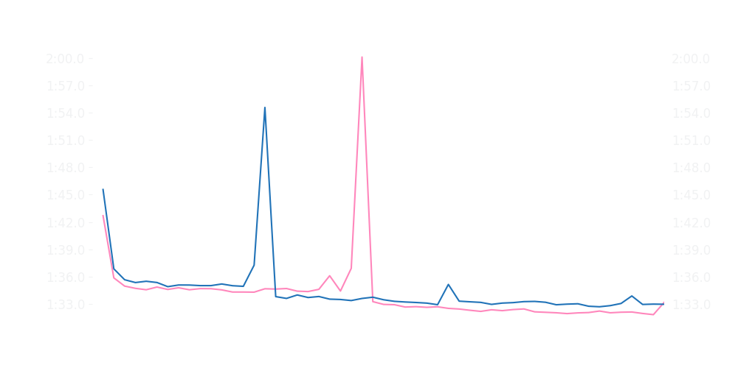
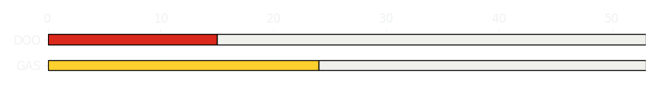
Japanese GP Race
Driver
Race Time
Race Time
Driver
Pierre Gasly
1:21:26.678
1:21:42.995
Jack Doohan
Avg Lap Time
1:33.169
IQR
Gap
Gap
IQR
Avg Lap Time
2.371 s
-19.192 s
+19.192 s
1.917 s
1:33.484
Race Comparaison
Race Comparaison
Lap Advantage
43/53
Position
13
Safety Car Lap
0/53
Position
15
Lap Advantage
10/53
Lap Time Per Lap
Lap Time Per Lap
Tyre Strategy
Total Pit Stop Time
00:26.041 s
Pit Stops
1
Pit Stops
1
Total Pit Stop Time
00:23.382 s
Tyre Strategy

Slide 3

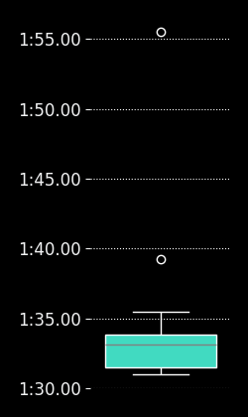
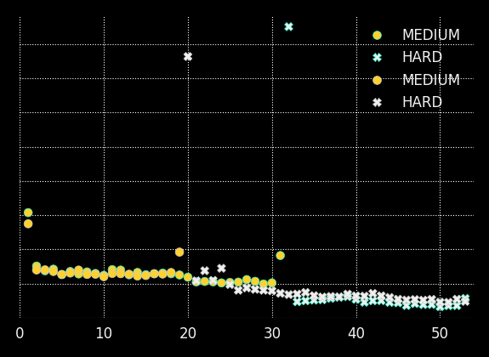
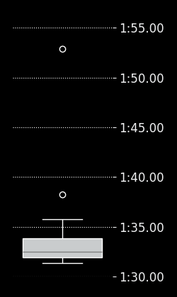
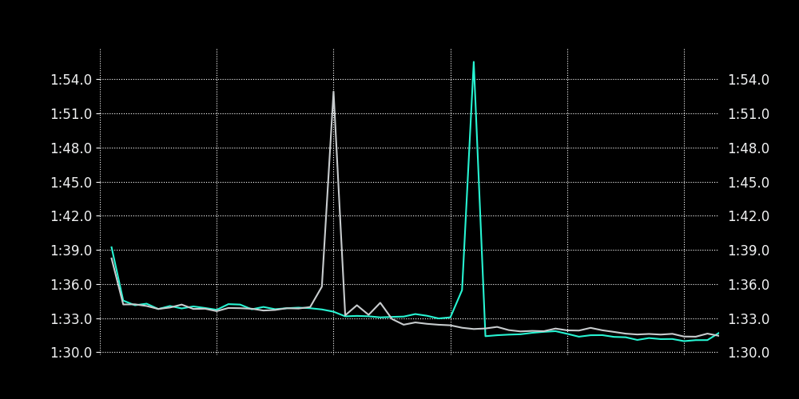
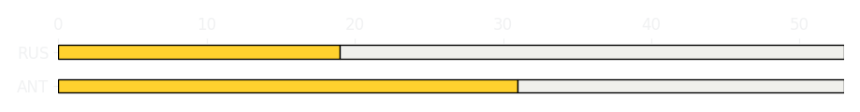
Japanese GP Race
Driver
Race Time
Race Time
Driver
Kimi Antonelli
1:20:46.689
1:20:46.360
George Russell
Avg Lap Time
1:33.147
IQR
Gap
Gap
IQR
Avg Lap Time
2.366 s
+01.309 s
-01.309 s
1.965 s
1:32.488
Race Comparaison
Race Comparaison
Lap Advantage
31/53
Position
6
Safety Car Lap
0/53
Position
5
Lap Advantage
22/53
Lap Time Per Lap
Lap Time Per Lap
Tyre Strategy
Total Pit Stop Time
00:24.380 s
Pit Stops
1
Pit Stops
1
Total Pit Stop Time
00:23.184 s
Tyre Strategy

Slide 4


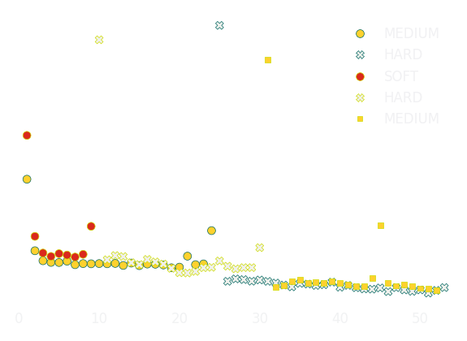
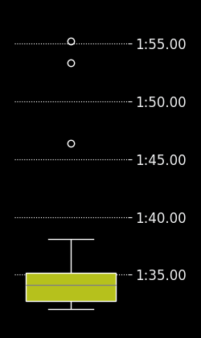
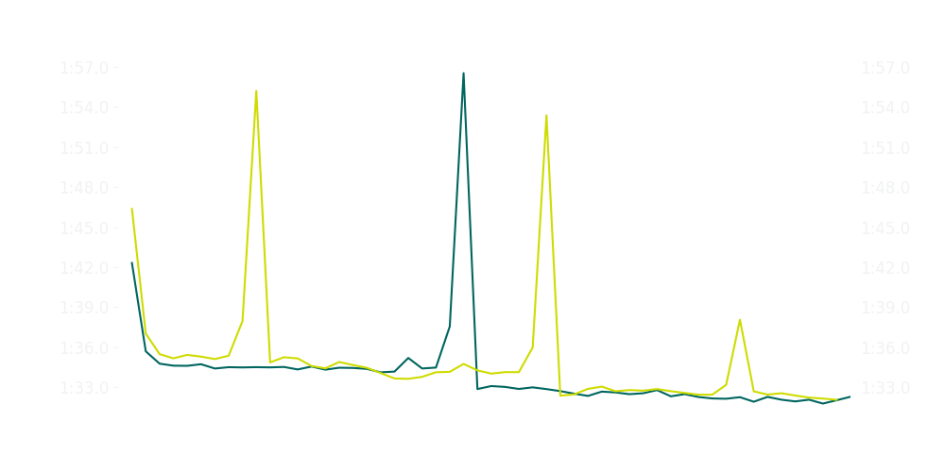
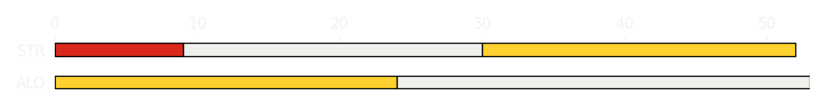
Japanese GP Race
Driver
Race Time
Race Time
Driver
Fernando Alonso
1:21:22.268
1:20:33.809
Lance Stroll
Avg Lap Time
1:33.018
IQR
Gap
Gap
IQR
Avg Lap Time
2.139 s
-1 laps
+1 laps
2.459 s
1:34.121
Race Comparaison
Race Comparaison
Lap Advantage
44/53
Position
11
Safety Car Lap
0/53
Position
20
Lap Advantage
9/53
Lap Time Per Lap
Lap Time Per Lap
Tyre Strategy
Total Pit Stop Time
00:25.708 s
Pit Stops
1
Pit Stops
2
Total Pit Stop Time
00:47.332 s
Tyre Strategy

Slide 5

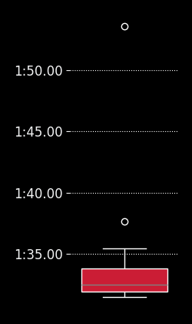
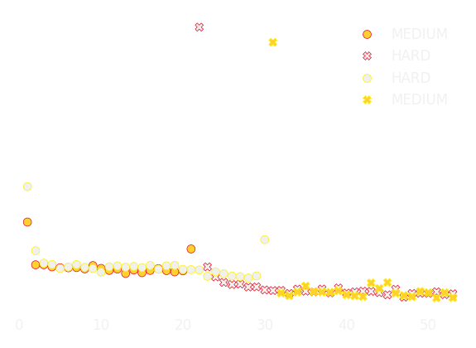
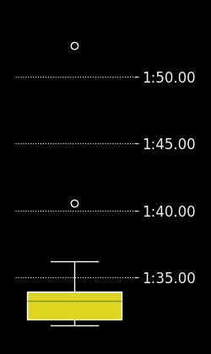
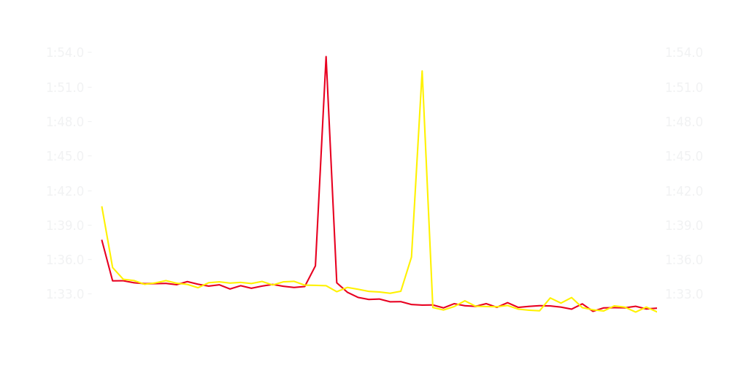
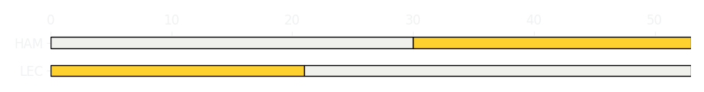
Japanese GP Race
Driver
Race Time
Race Time
Driver
Charles Leclerc
1:20:45.709
1:20:55.886
Lewis Hamilton
Avg Lap Time
1:32.503
IQR
Gap
Gap
IQR
Avg Lap Time
1.879 s
-13.085 s
+13.085 s
2.057 s
1:33.215
Race Comparaison
Race Comparaison
Lap Advantage
34/53
Position
4
Safety Car Lap
0/53
Position
7
Lap Advantage
19/53
Lap Time Per Lap
Lap Time Per Lap
Tyre Strategy
Total Pit Stop Time
00:23.346 s
Pit Stops
1
Pit Stops
1
Total Pit Stop Time
00:22.937 s
Tyre Strategy

Slide 6


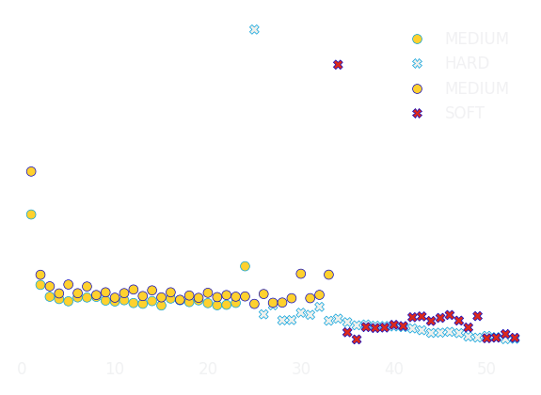
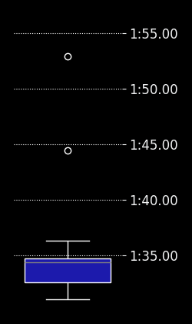
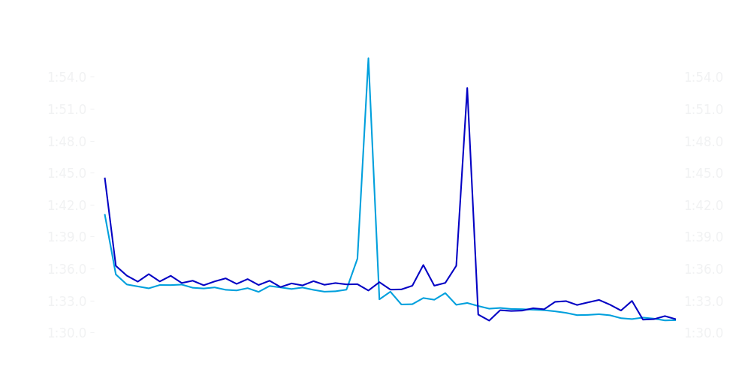
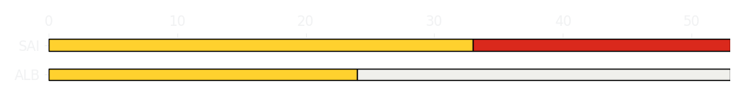
Japanese GP Race
Driver
Race Time
Race Time
Driver
Alexander Albon
1:21:06.564
1:21:36.906
Carlos Sainz
Avg Lap Time
1:33.693
IQR
Gap
Gap
IQR
Avg Lap Time
2.063 s
-33.762 s
+33.762 s
2.187 s
1:34.427
Race Comparaison
Race Comparaison
Lap Advantage
44/53
Position
9
Safety Car Lap
0/53
Position
14
Lap Advantage
9/53
Lap Time Per Lap
Lap Time Per Lap
Tyre Strategy
Total Pit Stop Time
00:23.093 s
Pit Stops
1
Pit Stops
1
Total Pit Stop Time
00:23.337 s
Tyre Strategy

Slide 7

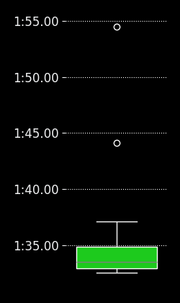
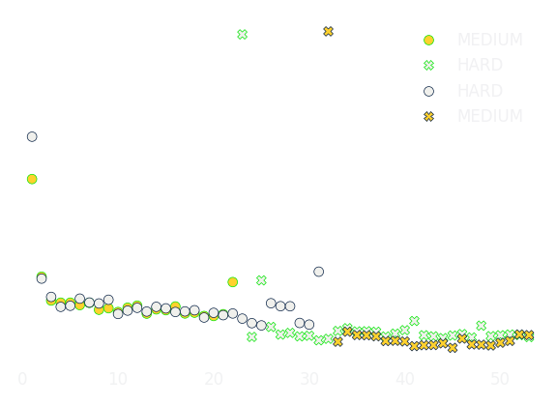

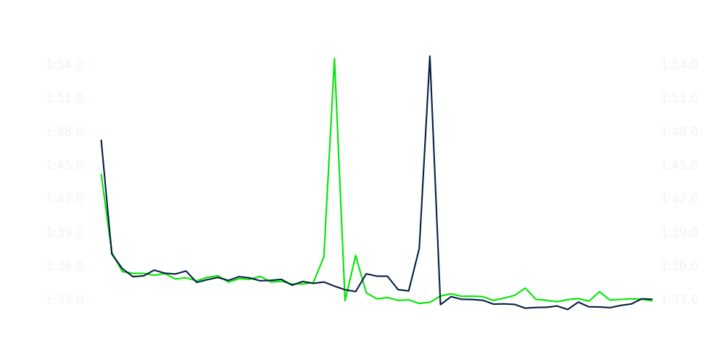
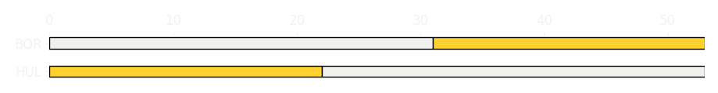
Japanese GP Race
Driver
Race Time
Race Time
Driver
Nico Hulkenberg
1:21:45.082
1:21:43.990
Gabriel Bortoleto
Avg Lap Time
1:33.529
IQR
Gap
Gap
IQR
Avg Lap Time
1.933 s
-1.94 s
+1.94 s
2.433 s
1:34.204
Race Comparaison
Race Comparaison
Lap Advantage
22/53
Position
16
Safety Car Lap
0/53
Position
19
Lap Advantage
31/53
Lap Time Per Lap
Lap Time Per Lap
Tyre Strategy
Total Pit Stop Time
00:23.515 s
Pit Stops
1
Pit Stops
1
Total Pit Stop Time
00:23.419 s
Tyre Strategy

Slide 8

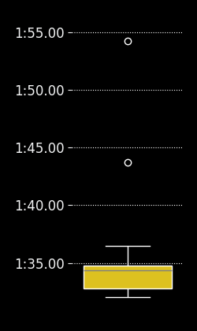
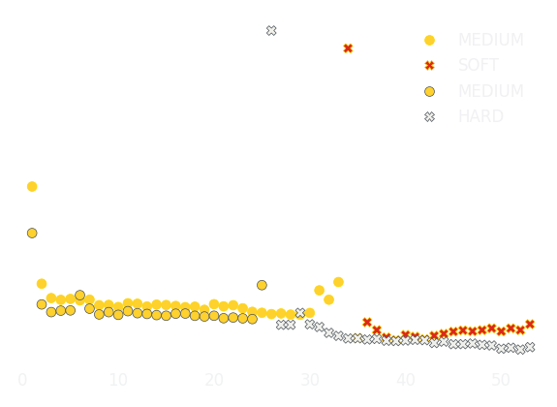

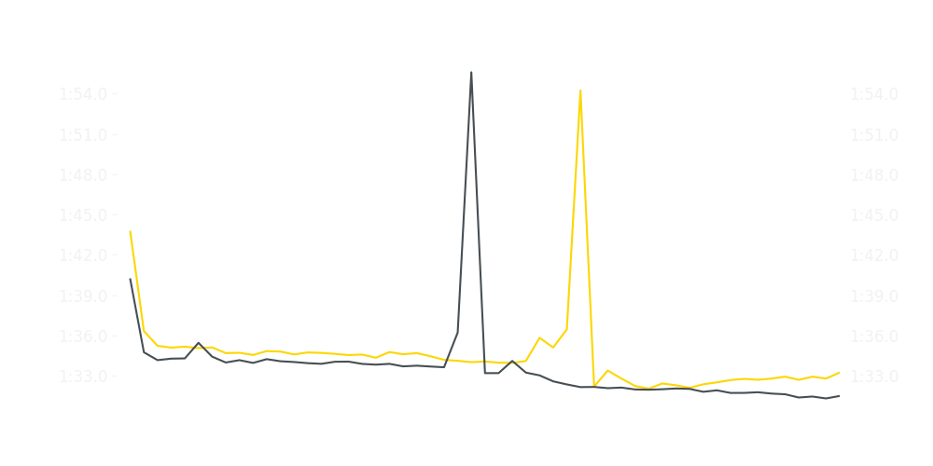
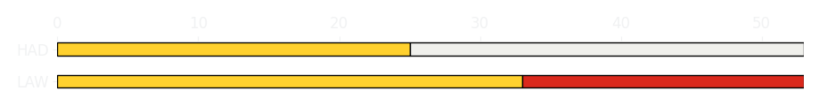
Japanese GP Race
Driver
Race Time
Race Time
Driver
Liam Lawson
1:21:46.254
1:21:04.193
Isack Hadjar
Avg Lap Time
1:34.342
IQR
Gap
Gap
IQR
Avg Lap Time
1.972 s
+45.600 s
-45.600 s
2.054 s
1:33.637
Race Comparaison
Race Comparaison
Lap Advantage
4/53
Position
17
Safety Car Lap
0/53
Position
8
Lap Advantage
49/53
Lap Time Per Lap
Lap Time Per Lap
Tyre Strategy
Total Pit Stop Time
00:23.662 s
Pit Stops
1
Pit Stops
1
Total Pit Stop Time
00:23.333 s
Tyre Strategy

Slide 9


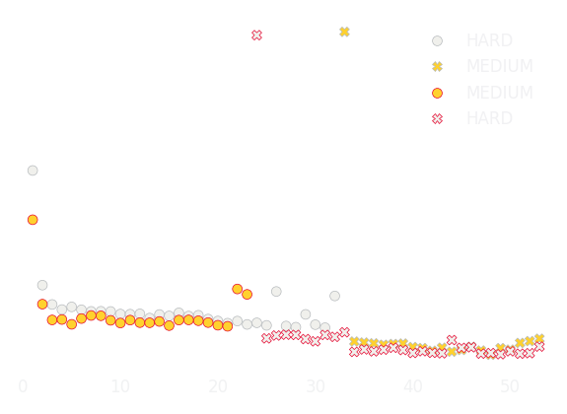
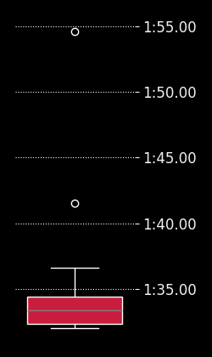
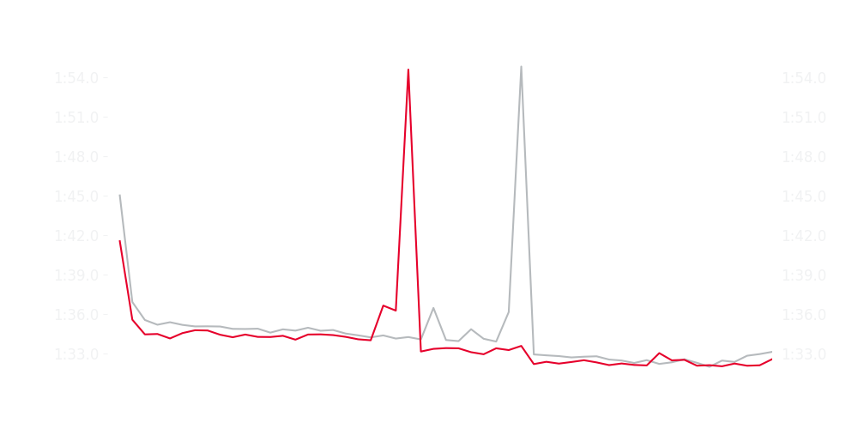
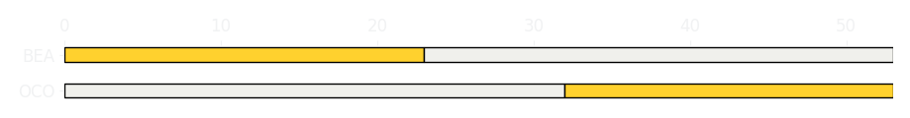
Japanese GP Race
Driver
Race Time
Race Time
Driver
Esteban Ocon
1:21:45.658
1:21:20.237
Ollie Bearman
Avg Lap Time
1:34.208
IQR
Gap
Gap
IQR
Avg Lap Time
2.102 s
+28.909 s
-28.909 s
2.075 s
1:33.375
Race Comparaison
Race Comparaison
Lap Advantage
6/53
Position
18
Safety Car Lap
0/53
Position
10
Lap Advantage
47/53
Lap Time Per Lap
Lap Time Per Lap
Tyre Strategy
Total Pit Stop Time
00:24.464 s
Pit Stops
1
Pit Stops
1
Total Pit Stop Time
00:24.834 s
Tyre Strategy

Slide 10

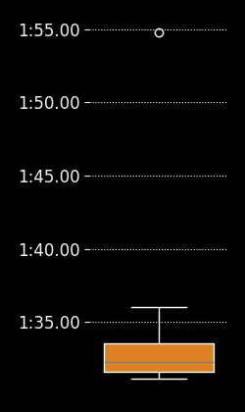
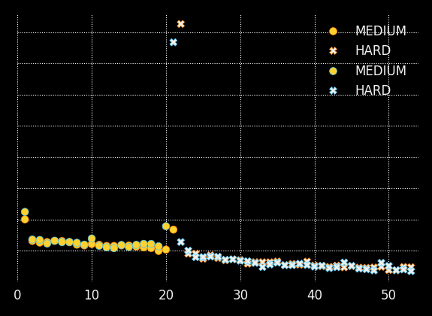

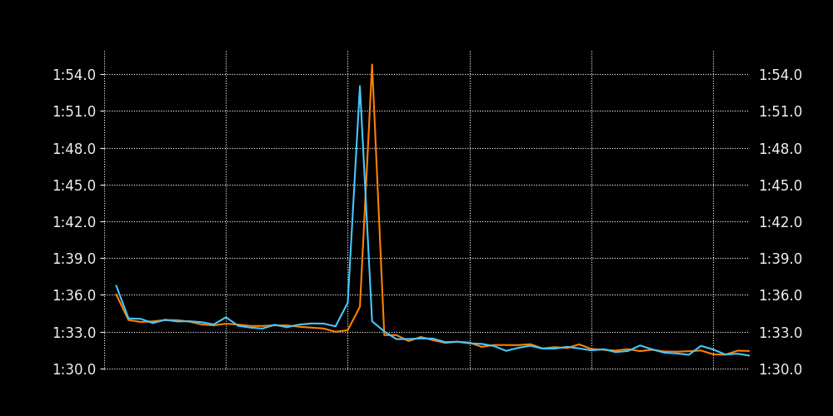
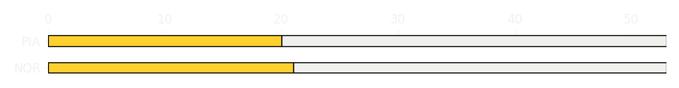
Japanese GP Race
Driver
Race Time
Race Time
Driver
Lando Norris
1:20:32.645
1:20:32.630
Oscar Piastri
Avg Lap Time
1:32.238
IQR
Gap
Gap
IQR
Avg Lap Time
1.926 s
-0.706 s
+0.706 s
2.045 s
1:32.386
Race Comparaison
Race Comparaison
Lap Advantage
28/53
Position
2
Safety Car Lap
0/53
Position
3
Lap Advantage
25/53
Lap Time Per Lap
Lap Time Per Lap
Tyre Strategy
Total Pit Stop Time
00:23.222 s
Pit Stops
1
Pit Stops
1
Total Pit Stop Time
00:23.037 s
Tyre Strategy

